Slide 1

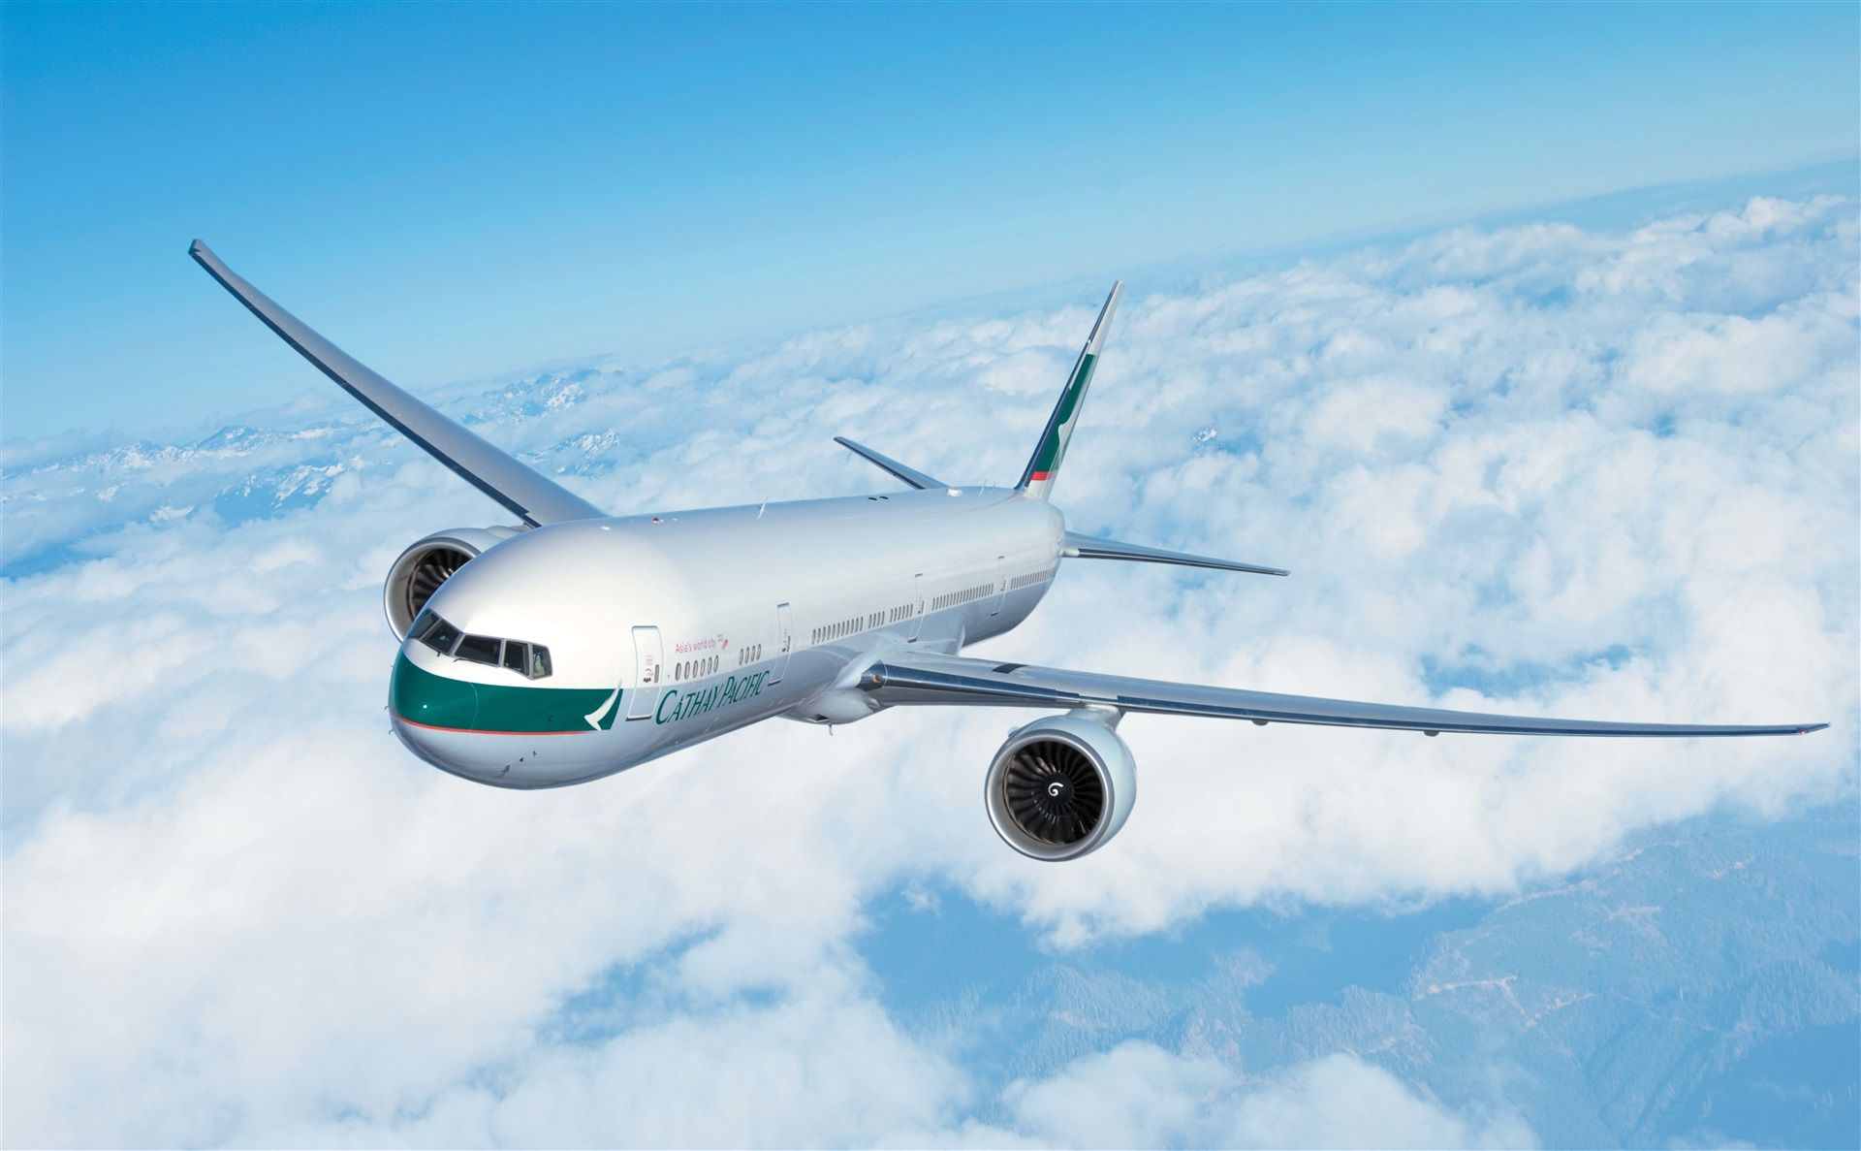
Flush System
Bill | David | Log G | Erik

Slide 2
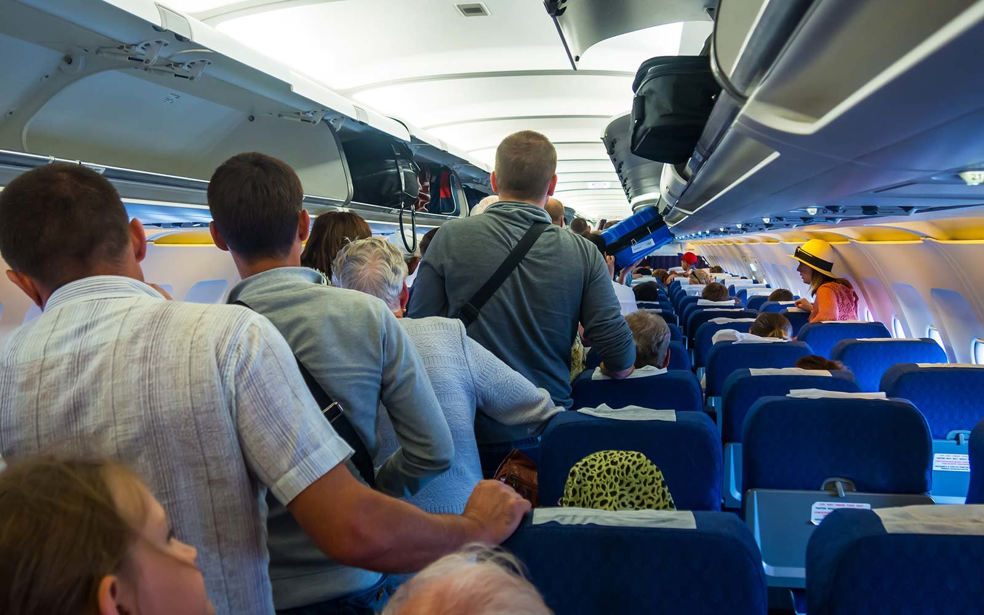
Problem
Long
queue
Aisles
Blockage
Safety
Hazard
Notes:
Interveiw with flight attendent
No one likes waiting
Blocks the aisles, which is real trouble to our flight attendents, imagine a person push back and fort
People especia Elderly should when there are unexpected tulburce

Slide 3
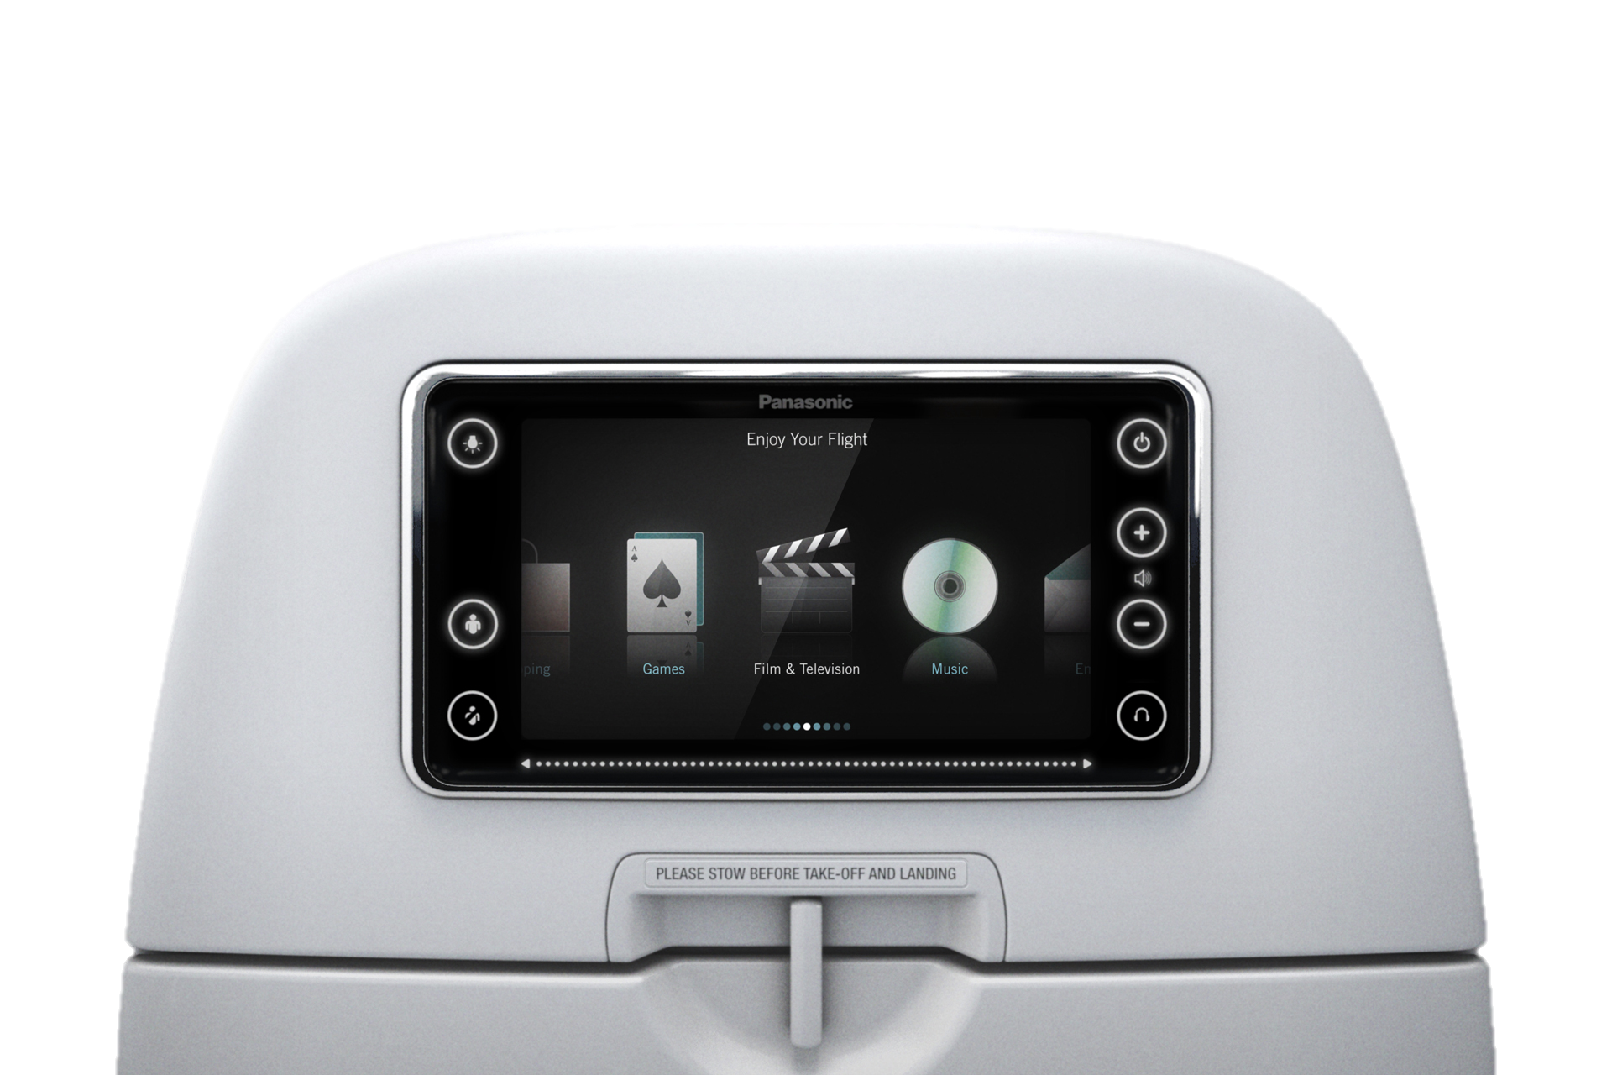
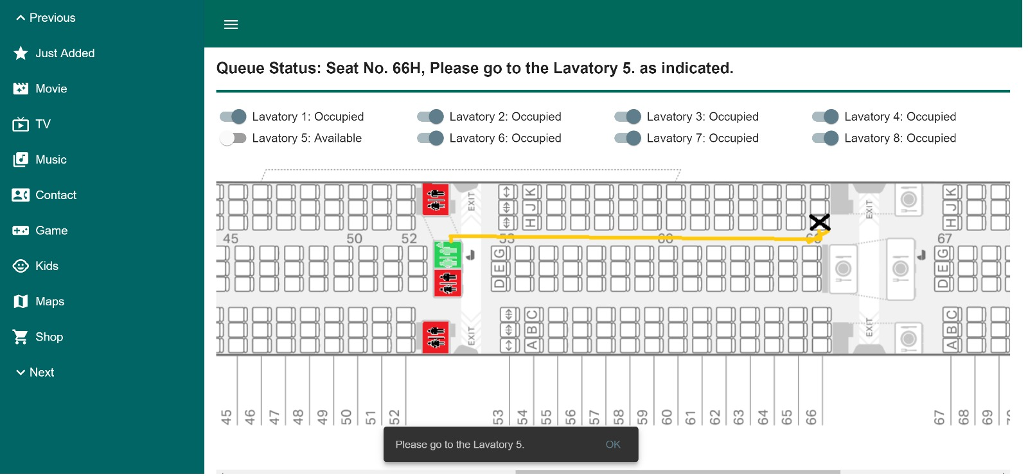
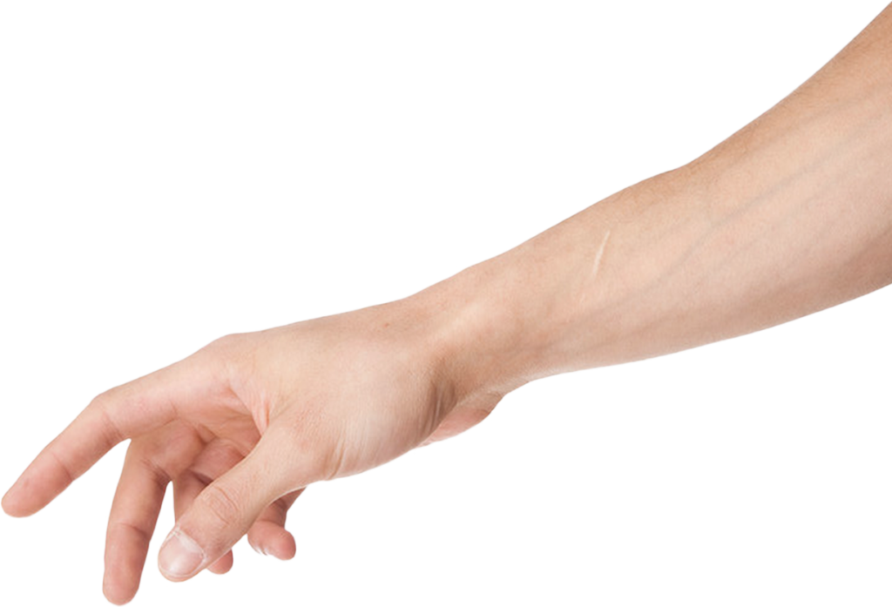
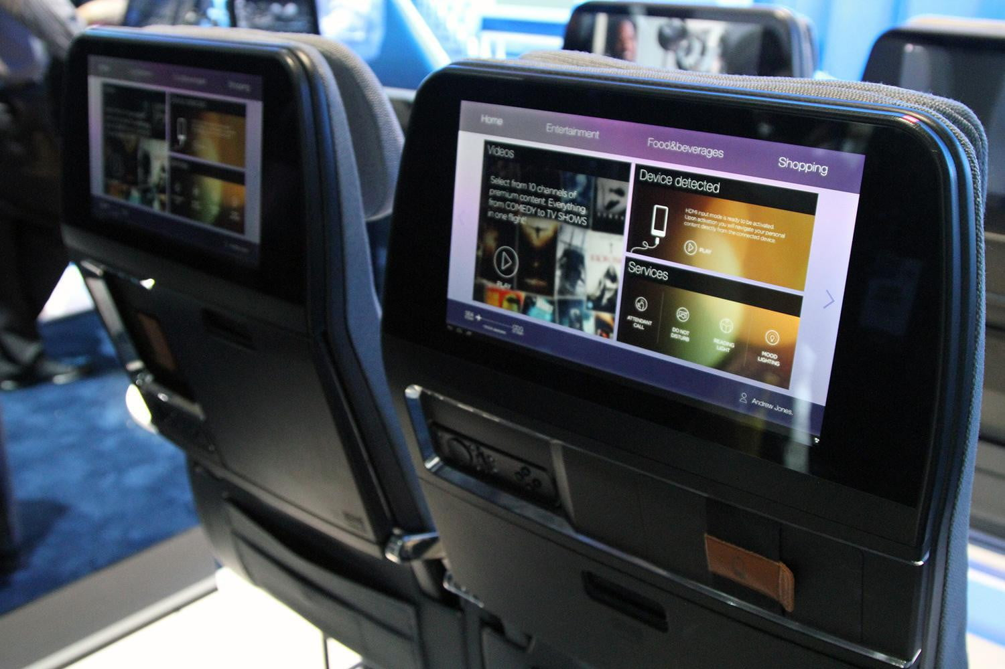
Queue on the Cloud
Flush System
Virtual
Queuing
Occupational Safety
Wait-time
Reduction
Optimized Toilet Service Allocation
Passenger
Safety
Smart Lock
FLYNESS
SURPRIZE
Sesame snaps jelly dessert tootsie roll sweet
Sesame snaps jelly dessert tootsie roll sweet
HUMOR
COFFEE
Sesame snaps jelly dessert tootsie roll sweet
Sesame snaps jelly dessert tootsie roll sweet
Notes:
On A330 flight, there are 48 passenger sharing the one toilet

Slide 4
LIVE DEMO

Slide 5
Advantage
Time
Saver
Clear
Aisles
Smoother
workflow
Notes:
Interveiw with flight attendent
No one likes waiting
Blocks the aisles, which is real trouble to our flight attendents, imagine a person push back and fort
People especia Elderly should when there are unexpected tulburce

Slide 6
Thank you!
FLUSH

Slide 7
Our Technology & User Journey
Request
Created
System
Prompt
Passenger
Uses toilet
Passenger
Adam
Put user in
Virtual queue
IoT WC
usage detection
Queue
Position(1)
Update
Queue
Calculate
Best WC
Dessert tiramisu sweet cotton candy bear claw lollipop. Chocolate bar sweet sweet roll croissant
Dessert tiramisu sweet cotton candy bear claw lollipop. Chocolate bar sweet sweet roll croissant
Dessert tiramisu sweet cotton candy bear claw lollipop. Chocolate bar sweet sweet roll croissant
Dessert tiramisu sweet cotton candy bear claw lollipop. Chocolate bar sweet sweet roll croissant
Dessert tiramisu sweet cotton candy bear claw lollipop. Chocolate bar sweet sweet roll croissant
Dessert tiramisu sweet cotton candy bear claw lollipop. Chocolate bar sweet sweet roll croissant
Notes:
Let me explained how we did it.

Slide 8
Competitive Advantage
Appendix: Cost analysis
Cost Item | Estimated Cost
Software Enhancement | HKD 50000
Digital Locks Purchase Cost | HKD 3000 per plane
Digital Locks Installation Cost | HKD 2000 per plane
Hardware Connection Cost (on aircraft) | HKD 1000 per plane
Total Cost | Lump Sum: 50000 Variable: 6000 per plane

Slide 9
Competitive Advantage
Appendix: Alternative use cases
In case of emergency / tend to use the conventional washroom
1-2 conventional washrooms that is the least disruptive to operation
Optimize the flow while catering to alternatives

Slide 10
Competitive Advantage
Appendix: Algorithm criteria
Availability of washrooms - tracking vacancy of washrooms obviously
Position of the food trolley – minimize the disturbance to flight attendance
Individual characteristics
Seat position – recommend for washroom on the same side
Having difficult moving – recommend closer washrooms

Slide 11
Competitive Advantage
Appendix: Implementation Phase
Phase 1: Familiarization Stage
- get used to making appointment
- used more familiar item, e.g. air ticket as identification
Phase 2: Bridging Stage
- use other identification method to improve efficiency
- possible technology: identification bracelet similar to RFID
Phase 3: Expansion Stage
- integrate other use case to the application + bracelet
- application: in-flight catering, service request (blanket etc.)
- bracelet: flight reminder / passenger tracking before departure

